Slide 2
What do you know about AJ2025?
What have you heard?
What would you like to do at AJ2025?

Slide 3
What’s covered in this session?
The Program
Transport
What, where, how
Fees
Fundraising
Eligibility

Slide 4
Where is AJ2025?

Slide 5
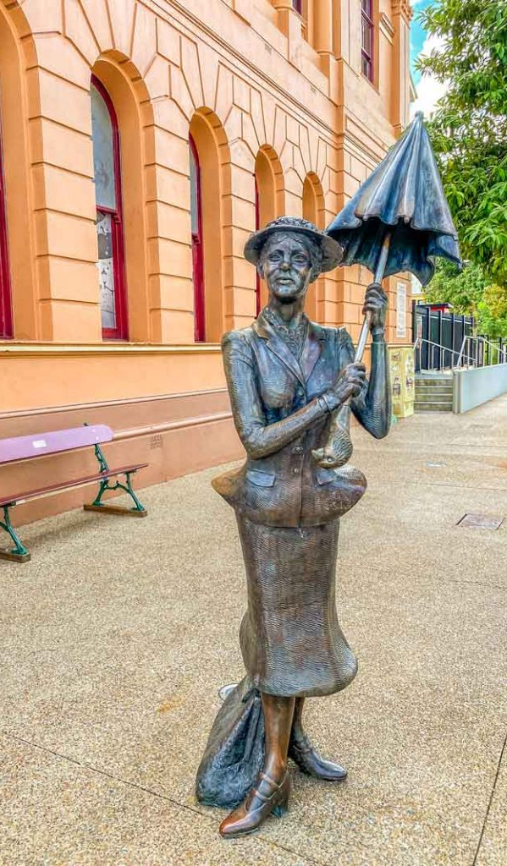
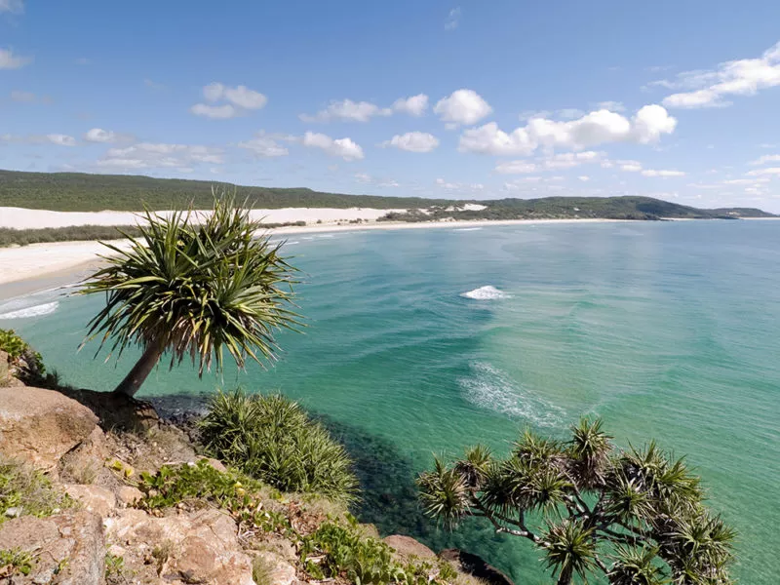
Maryborough Queensland
Population 15,000
3 hours north of Brisbane
Maryborough Showgrounds & Equestrian Park

Slide 6
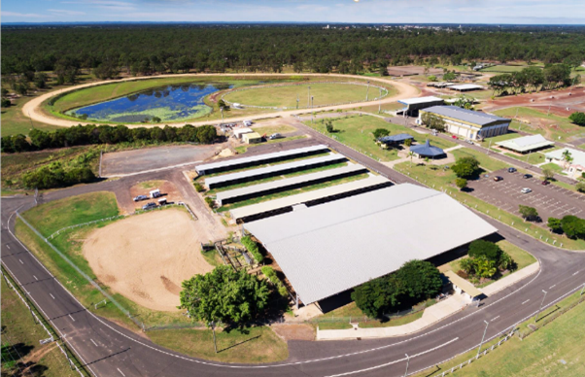

Slide 7
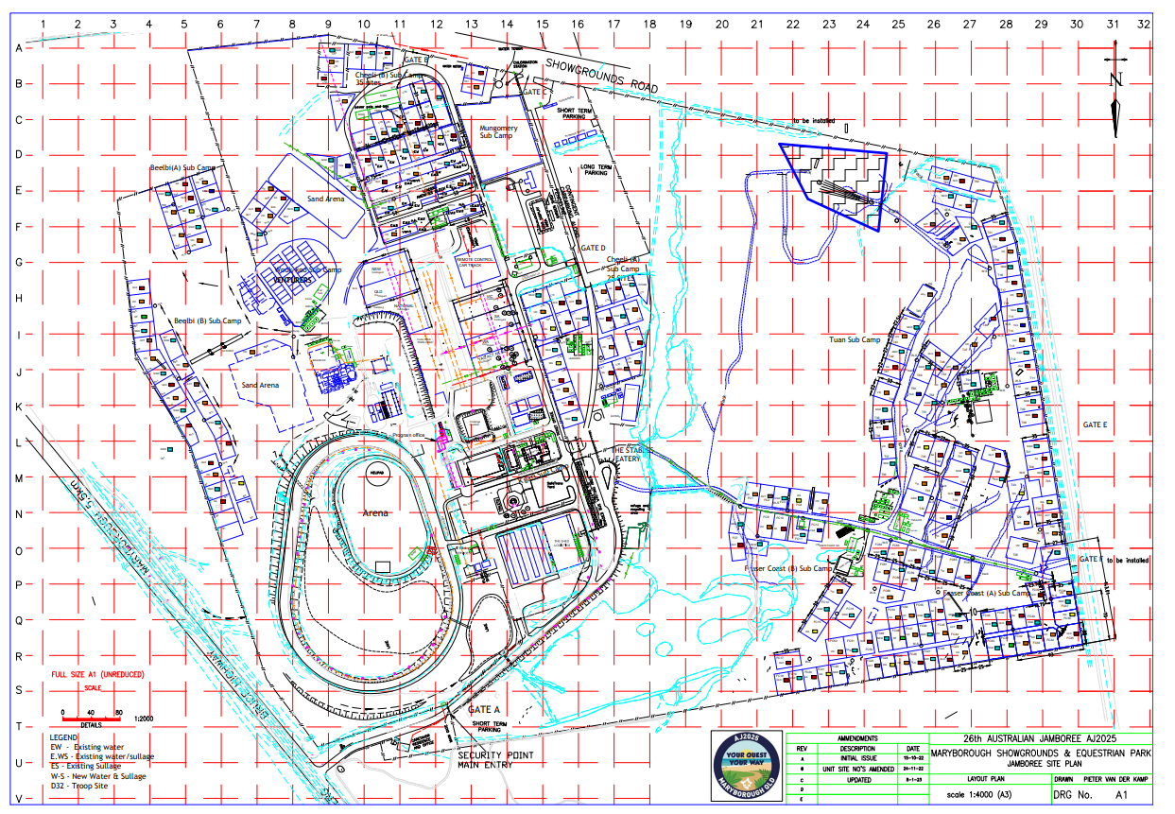

Slide 8
The Program is designed to be

Slide 9
Daily Program
7 Day program
1 Day with everyone onsite
Tier 3 activities for set up and pack down days
8 onsite zones
3 offsite zones
Entertainment precinct

Slide 10
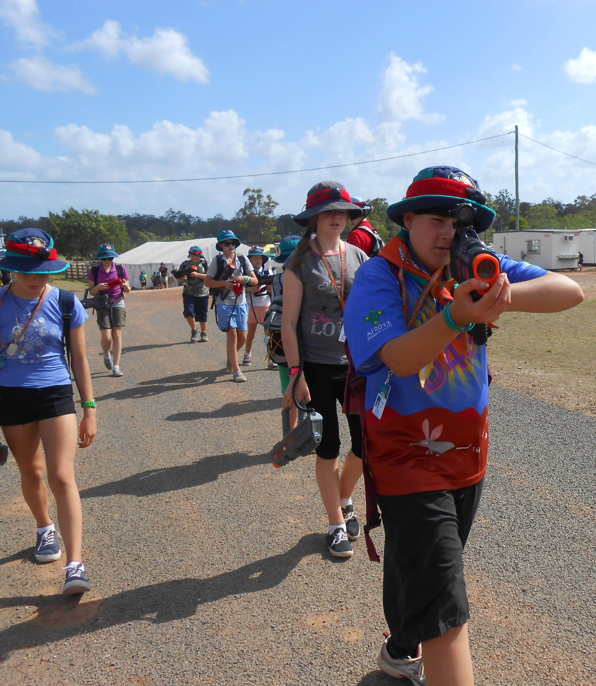
Onsite: Your Action
Activities could include:
Archery
Water or Laser or nerf tag
Skate boards
Wheelchair footy
Graffiti wall
Water Rockets

Slide 11
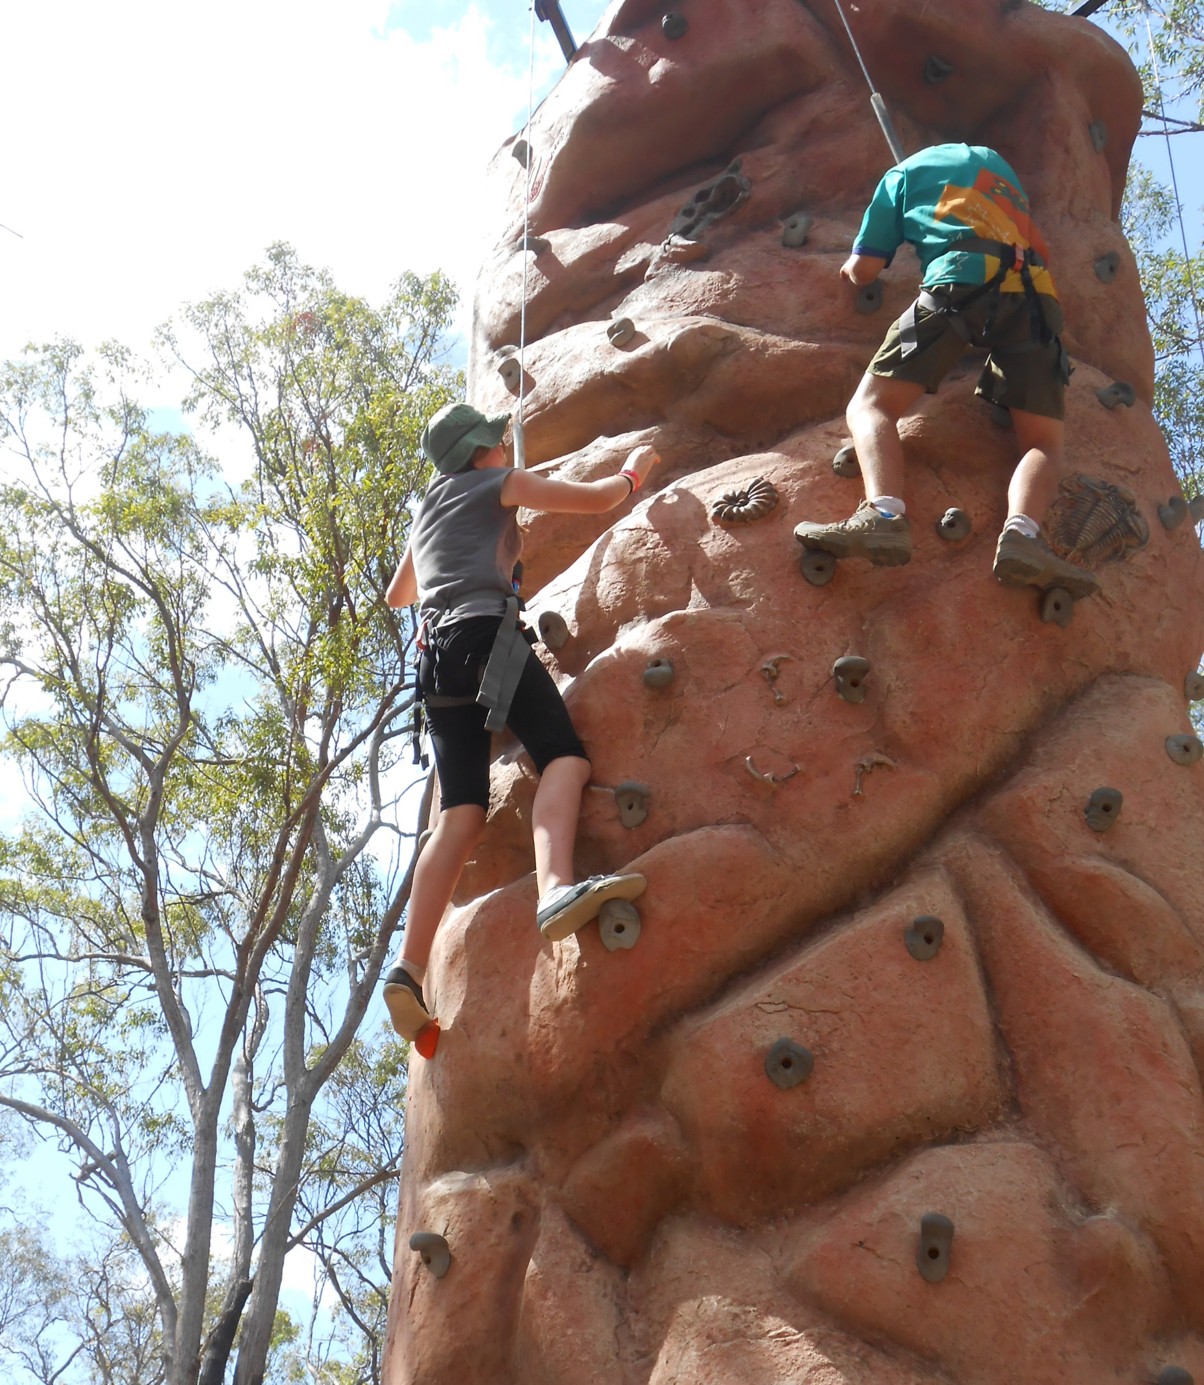
Onsite: Your Adventure
Activities could include:
Abseiling
Caving
Climbing wall
Crate stacking
Flying fox
Zip line

Slide 12
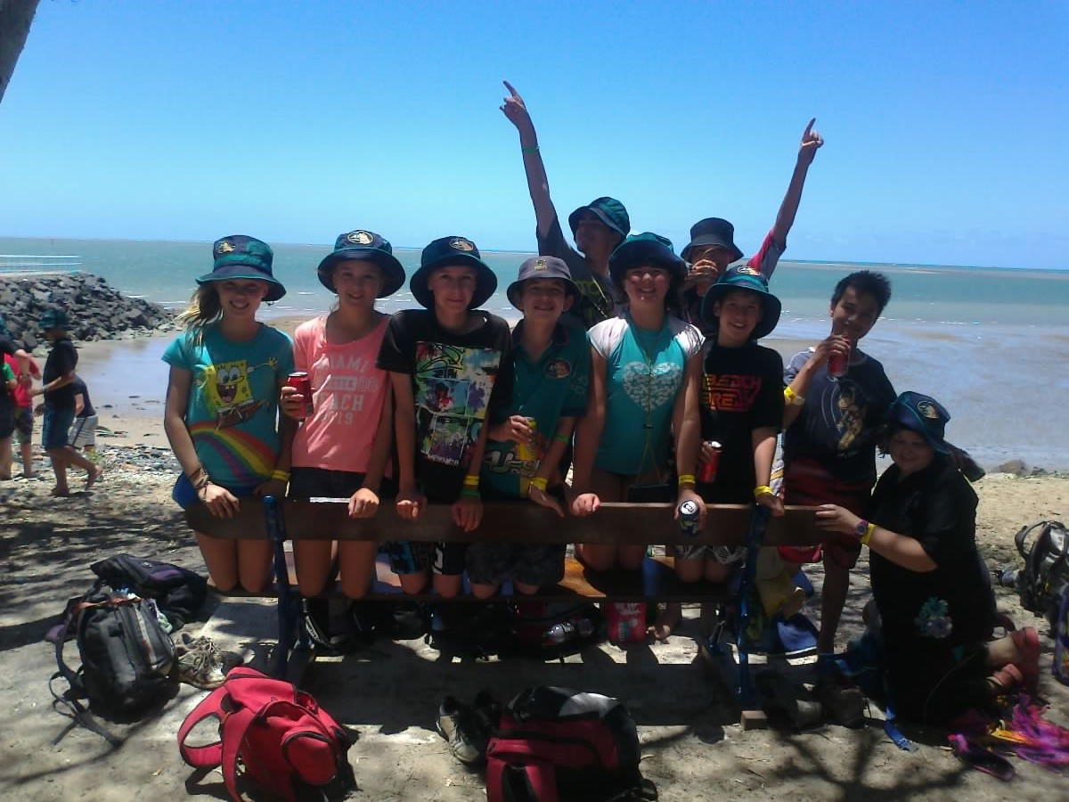
Onsite: Your Challenge
Activities such as
Obstacle course
Mud run
Frisbee golf
Colour Run

Slide 13
Onsite: Your Choice (tier 3)
Escape rooms
Heritage
NAVY VR Submarine
Virtual reality
Drone races
Amateur radio
Flight simulator

Slide 14
Your Craft (tier 3)
3D printing
Decorate mug or plate
Woggles
Key ring
Leather stamps

Slide 15
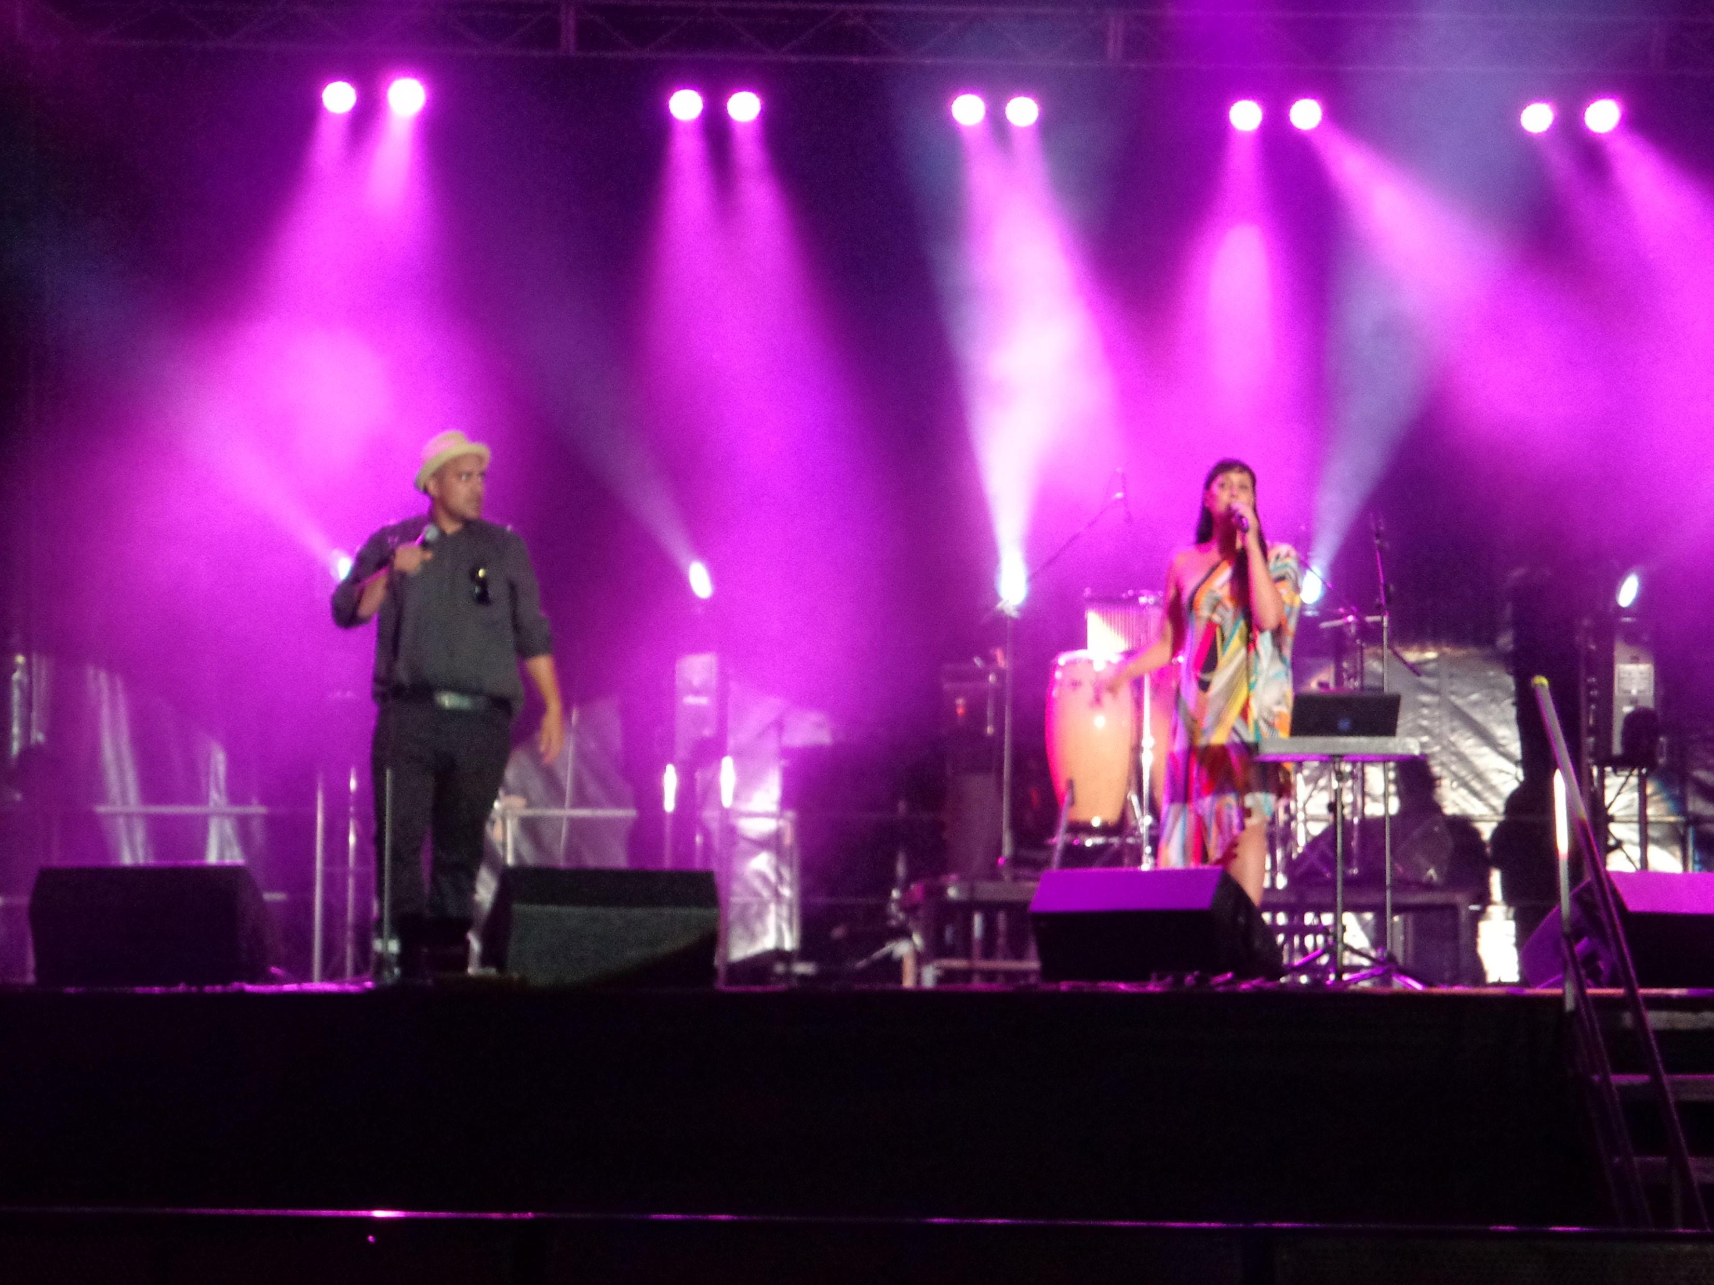
Your Performance
Activities such as
Circus skills
Drama
Green screen videos
Juggling
Puppetry
Theatre sports

Slide 16
Your Tech
Activities could include
Artificial Intelligence
Solar projects
Electronics

Slide 17
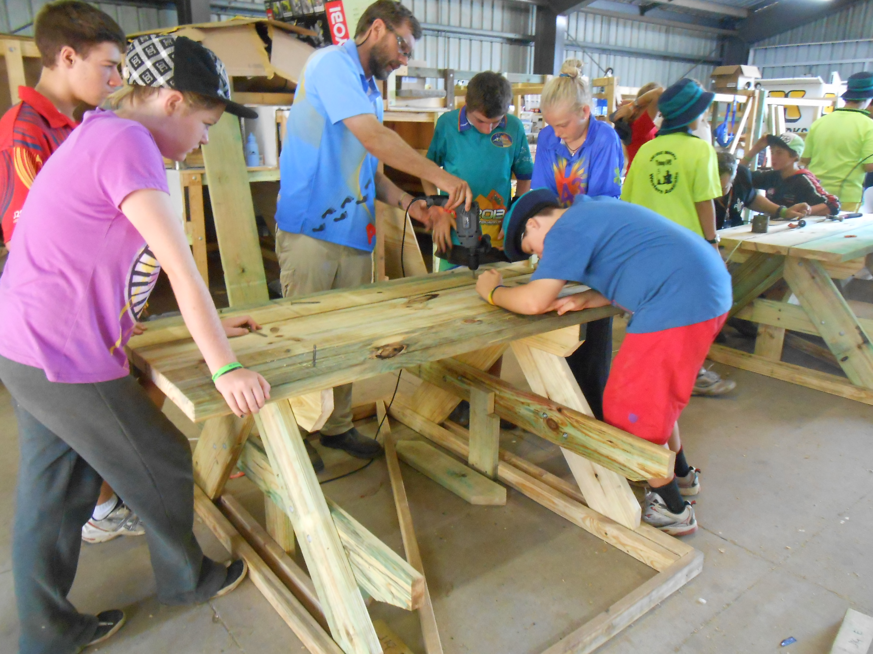
Your Trade
Activities could include
Landscaping
Concreting
Welding
Plumbing, Electrical, Carpentry
Pottery
Wood turning

Slide 18
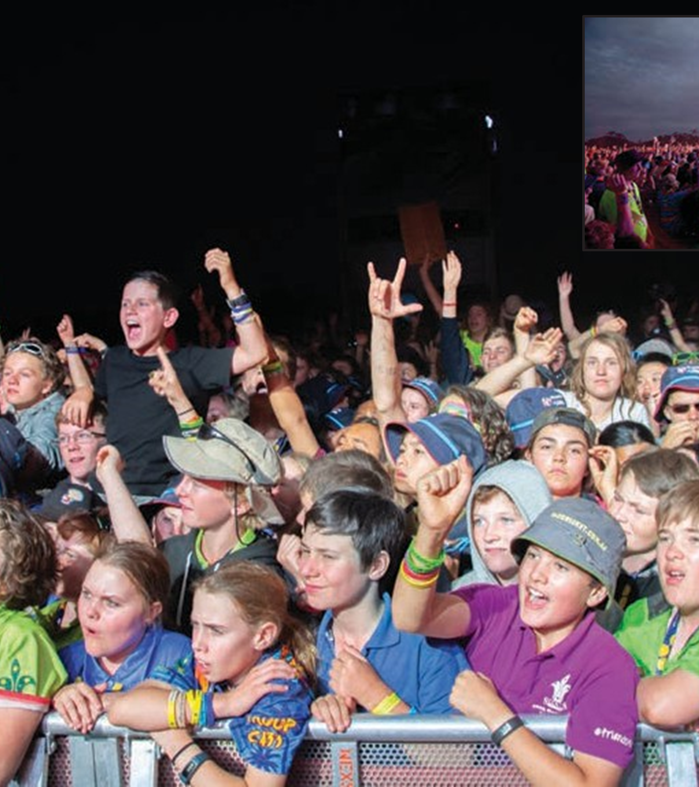
Night Activities
Wide games
Carnival night, Aussie Rock night, Tribute bands
Bush dance – Country and Western night
Movie night (New release)
Multi-cultural /International night
Foam party – wet night
Quiet night – Sub Camp entertainment
Magic night

Slide 19
Mini Arena
Radio Station
Streaming radio
Jamboree’s Got Talent

Slide 20
Your Pursuit
Market Day
Future Scout Day
Visitors Day
Challenge Wide Game

Slide 21
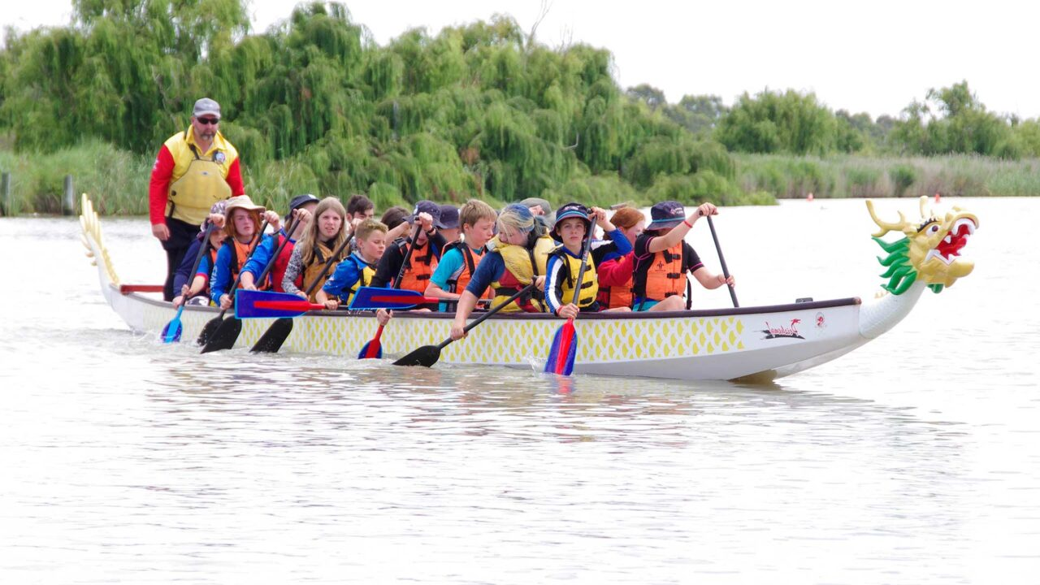
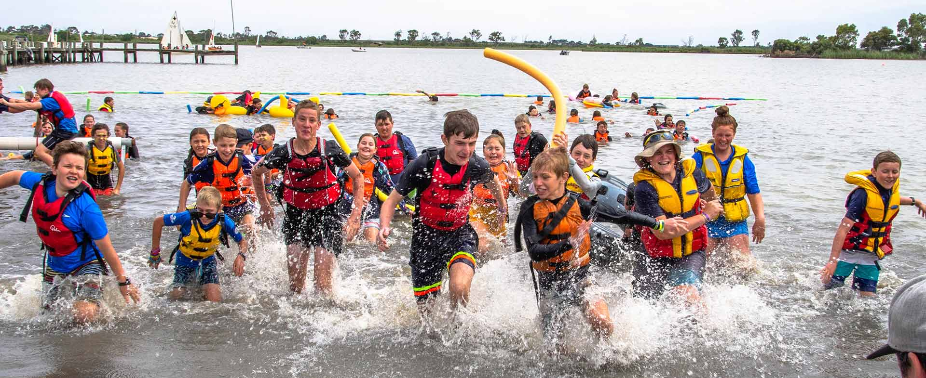
Offsite: Your Seaside – Water based
Rubber ducks
Snorkelling
Swimming
Sand sculpture
Beach games
Stand up paddle boards

Slide 22
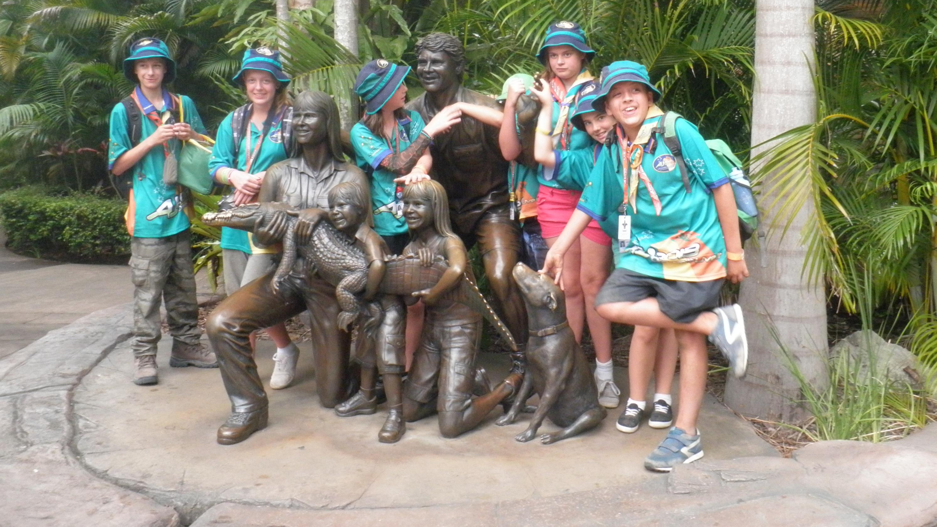
Offsite: Australia Zoo
Day Trip to Australia Zoo

Slide 23
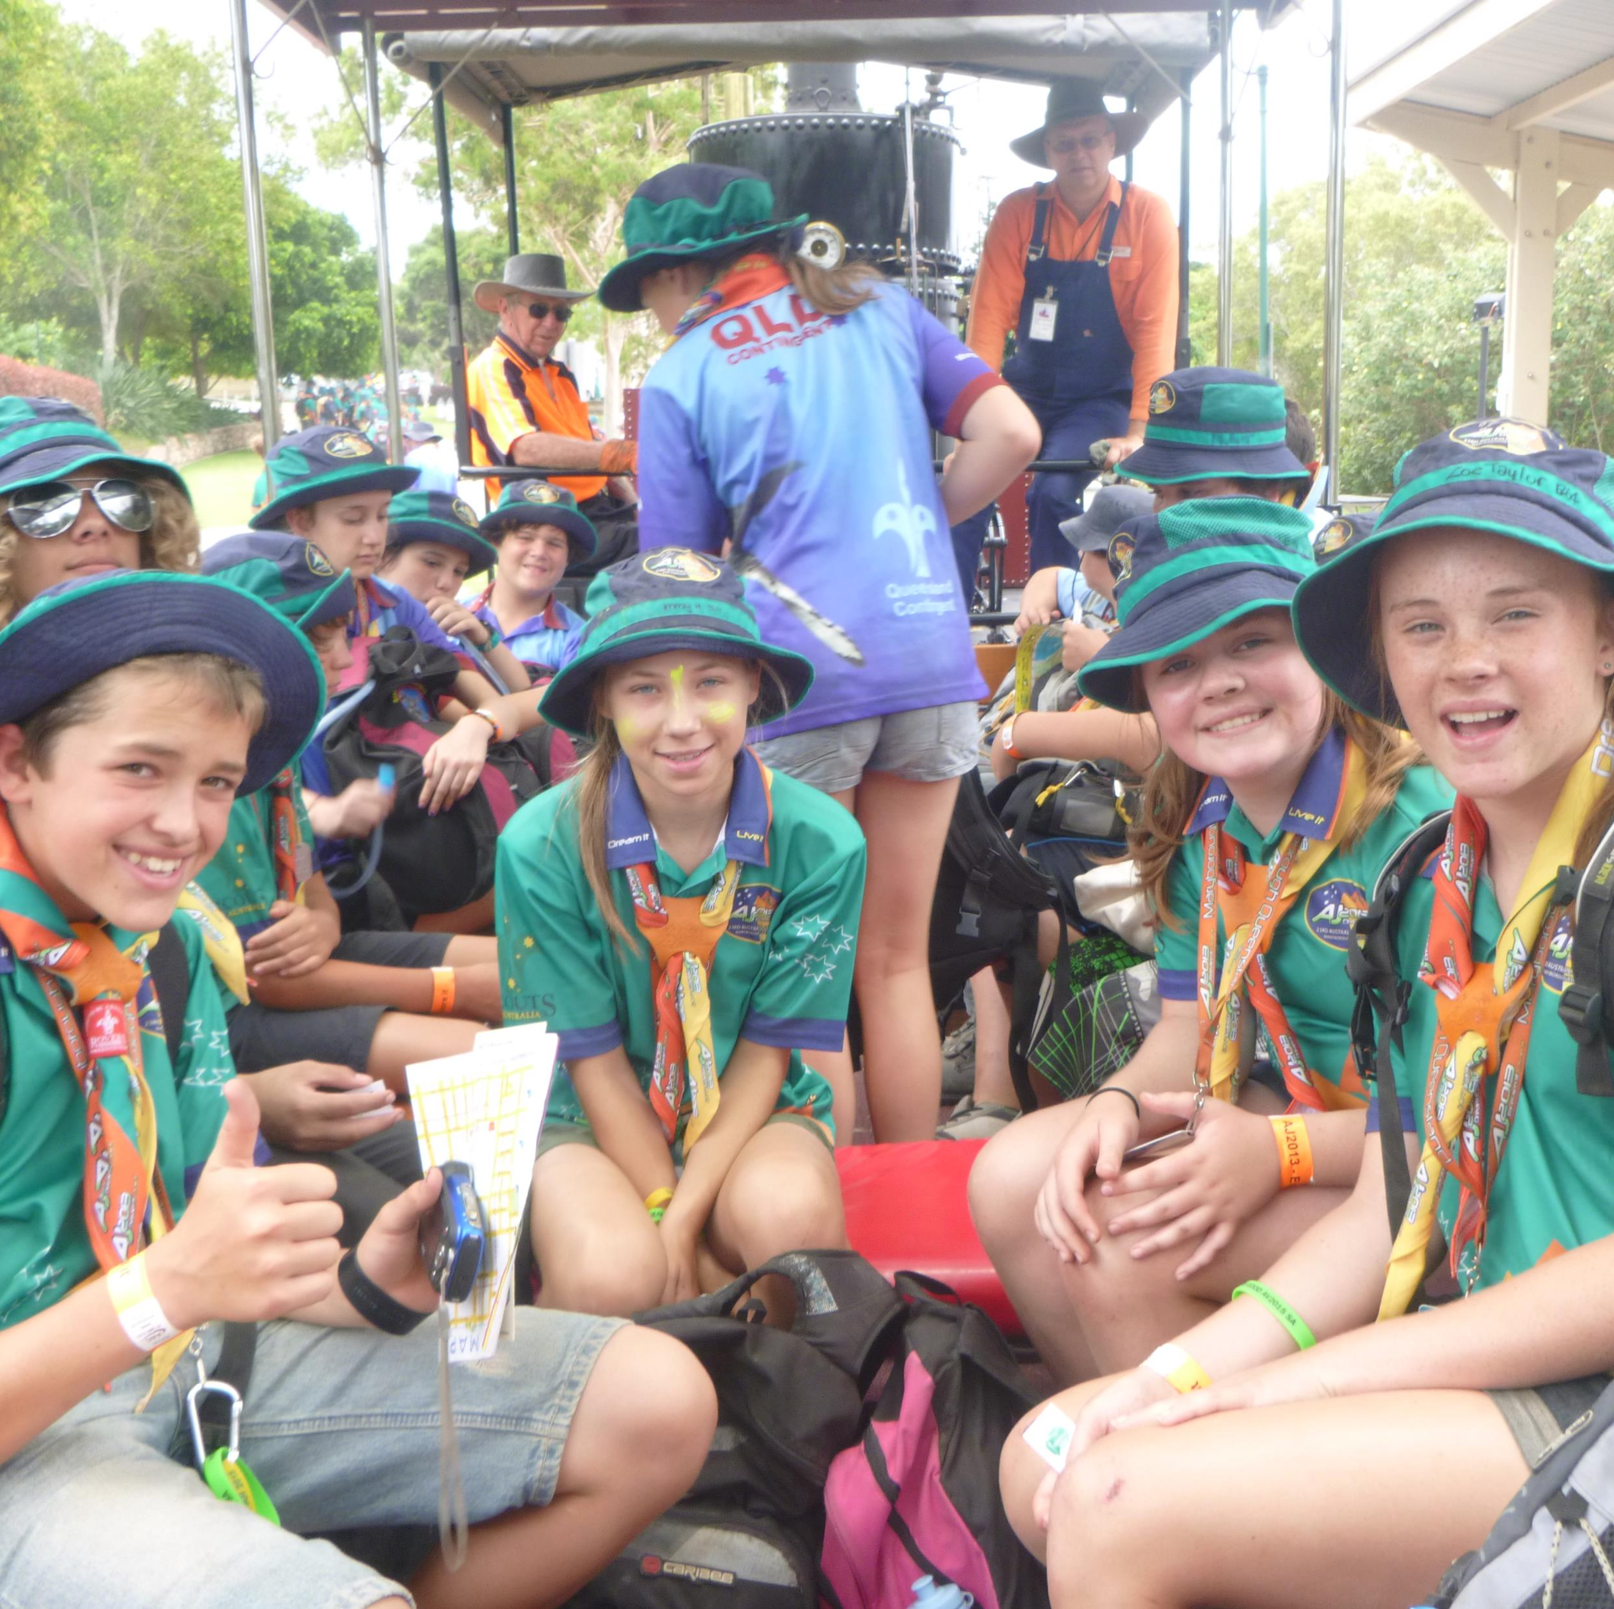
Offsite: Your Sights – Maryborough Tour
Wide game
Train ride
Military museum
Legacy art
Food experiences
Scavenger Hunt
Urban Challenge

Slide 24
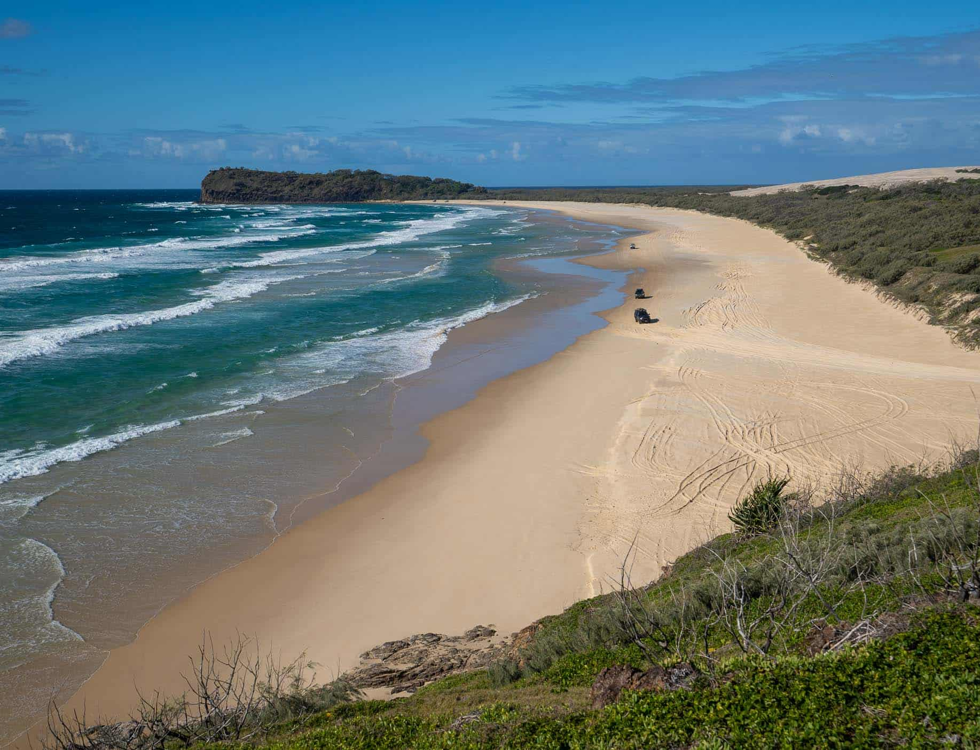
Your Getaway – Leader Tours
Fraser Island
Local tours
Barrier reef tour

Slide 25
The Program

Slide 26
The Scout Method

Slide 27
Milestones
Participation in activities
Focus on achieving Milestone 1
Your weekly program
Participation
Assisting
Leading

Slide 28
Outdoor Adventure Skills
Important skills to have in the lead up to AJ2025
Bushcraft, Bushwalking, Camping
Other activities during AJ2025 can sign off I-Statements

Slide 29
Special Interest Areas
Opportunities prior to Jamboree
Use something from Jamboree as a start for a project in the future

Slide 30
When is AJ2025?
Monday 6 January 2025 – Opening Ceremony
Wednesday 15 January 2025 – Closing Ceremony

Slide 31
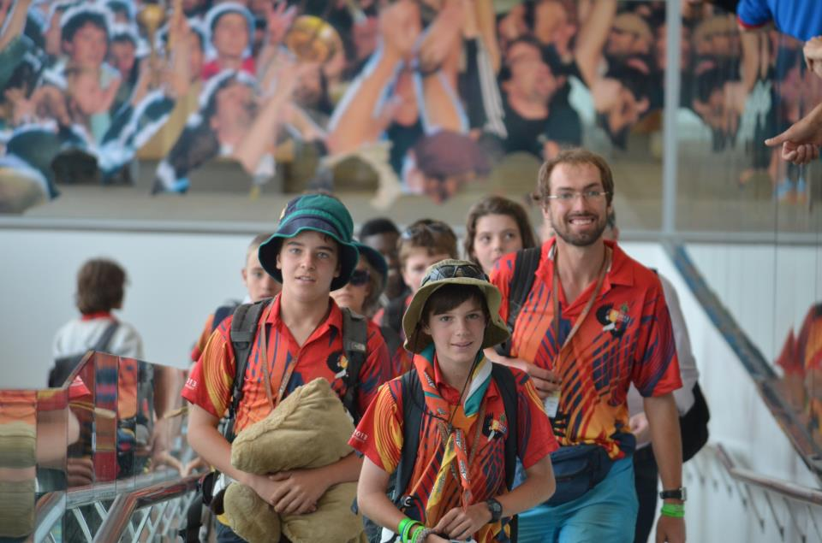
How do we get there?
From Adelaide Airport
Drop off at airport
Pick up on return
Flights to / from Brisbane
Bus to / from Maryborough

Slide 32
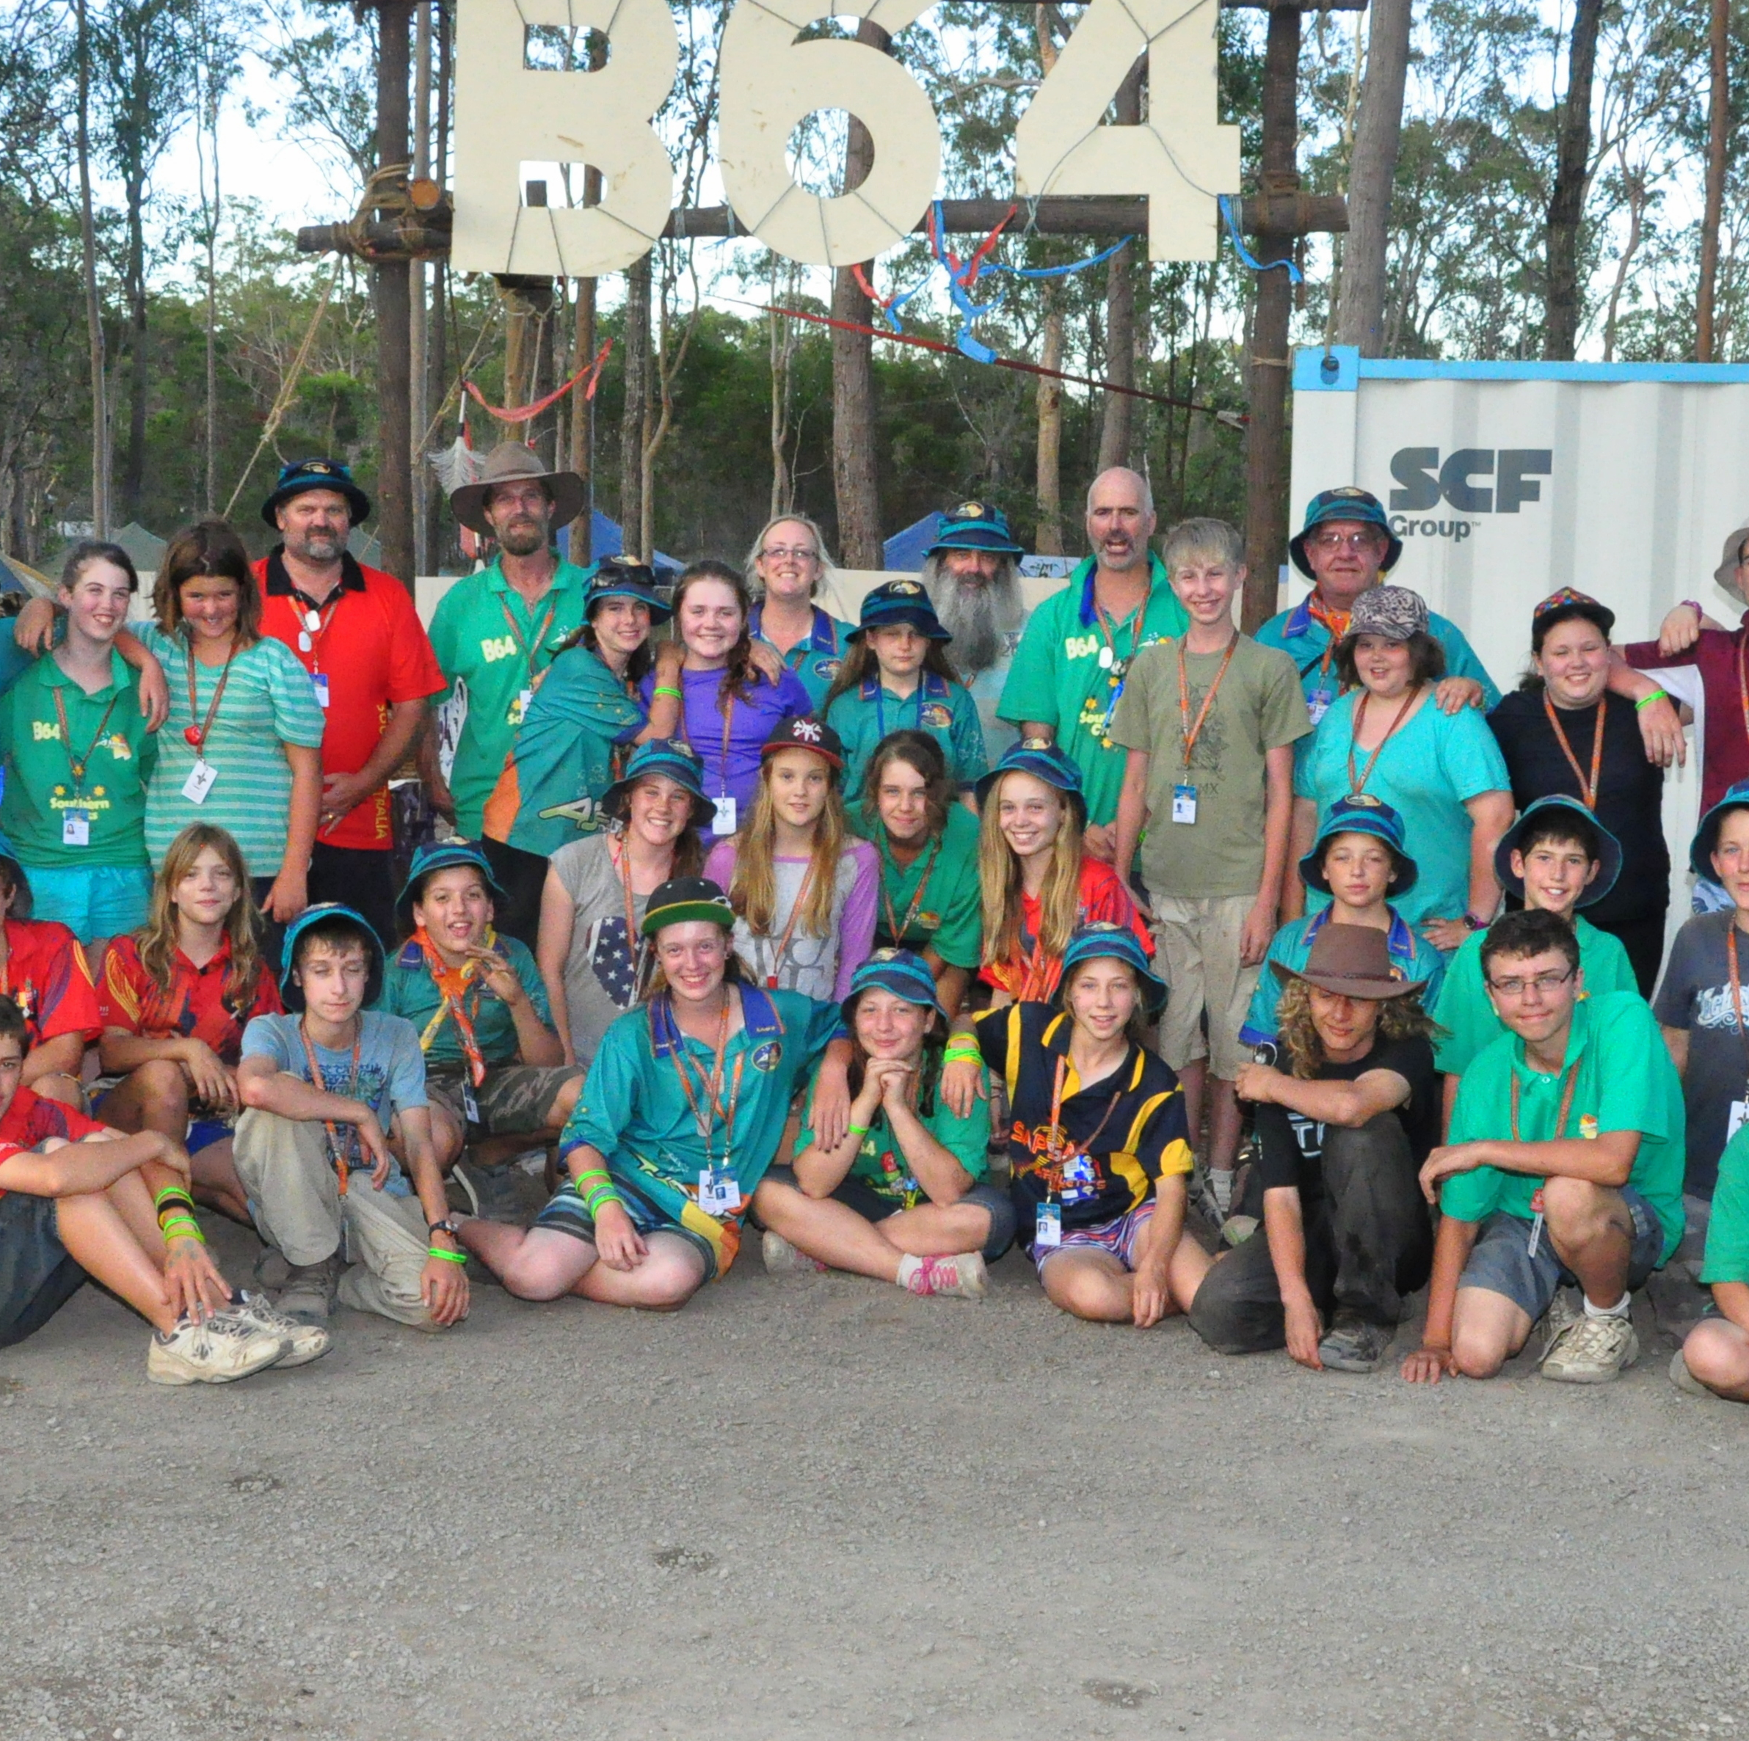
My Jamboree Unit
5 Leaders
36 Scouts divided into Patrols
Units may have Youth Members from several Groups
Your Unit will meet several times before Jamboree
You will get to know all the other Scouts and Leaders

Slide 33
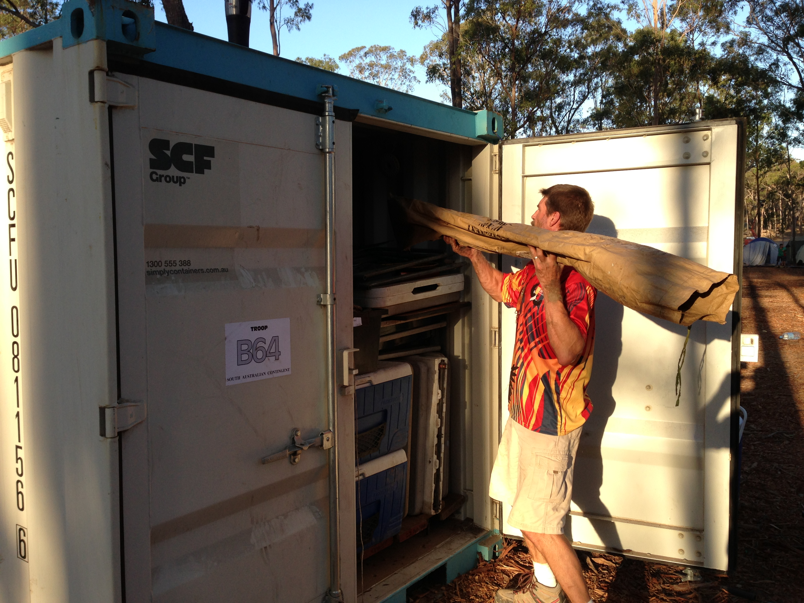

Slide 34
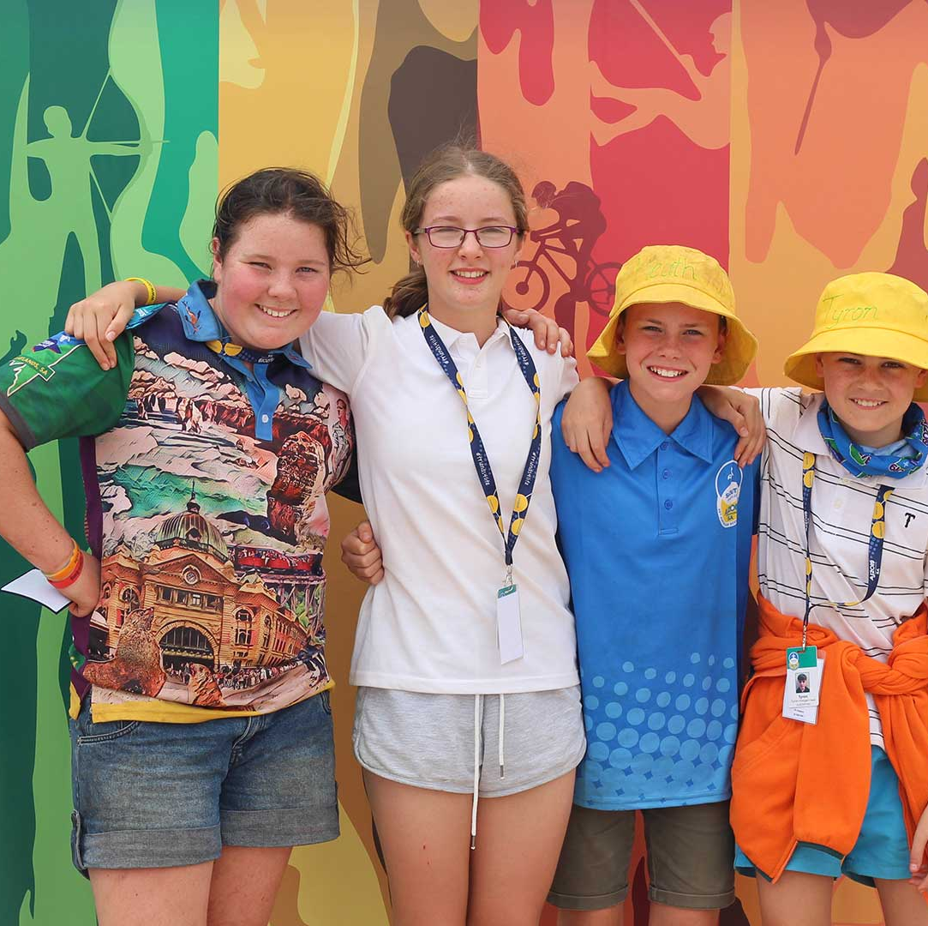
Youth Leadership Roles
Patrol Leader
Assistant Patrol Leader
Unit Leaders
Selected from within the Unit
Important roles

Slide 35
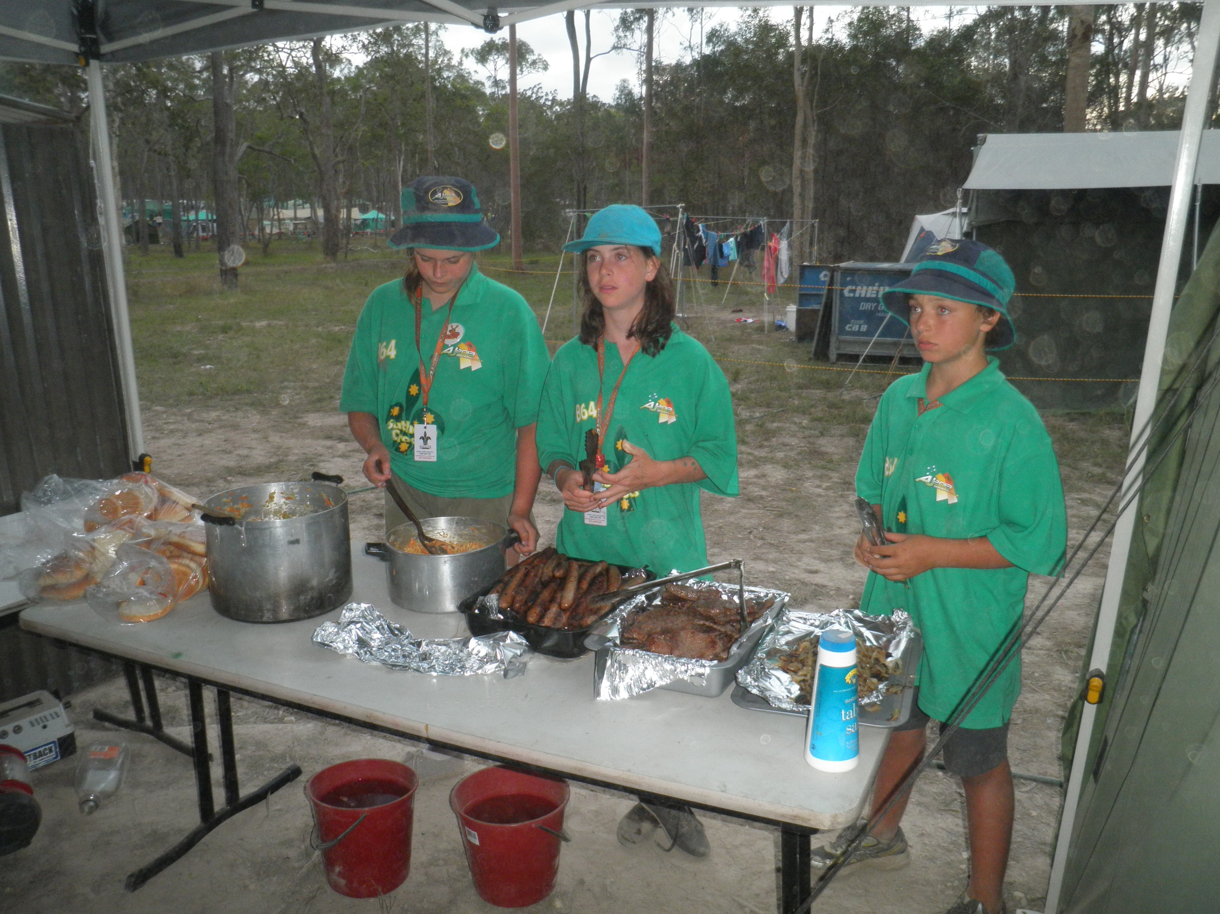
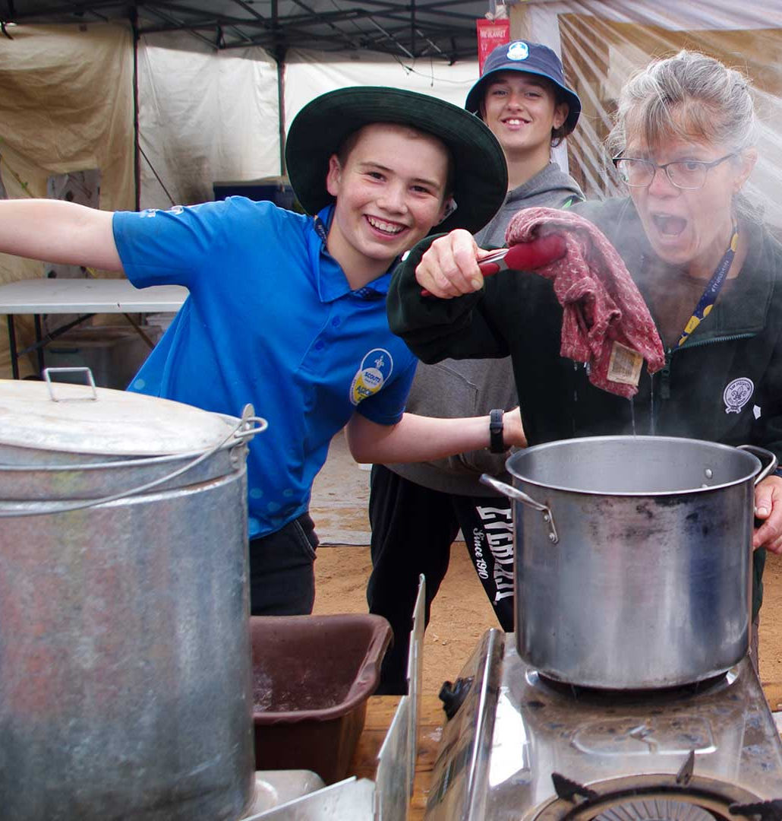
What do we eat?
Food is obtained from store in your Sub Camp
Menu varies
Who cooks?
Special diets catered for

Slide 36
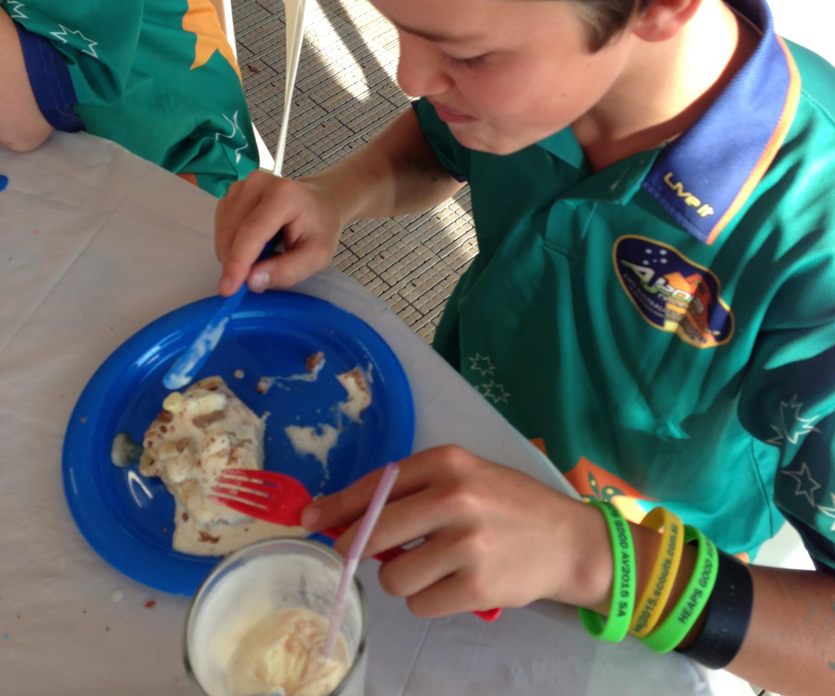
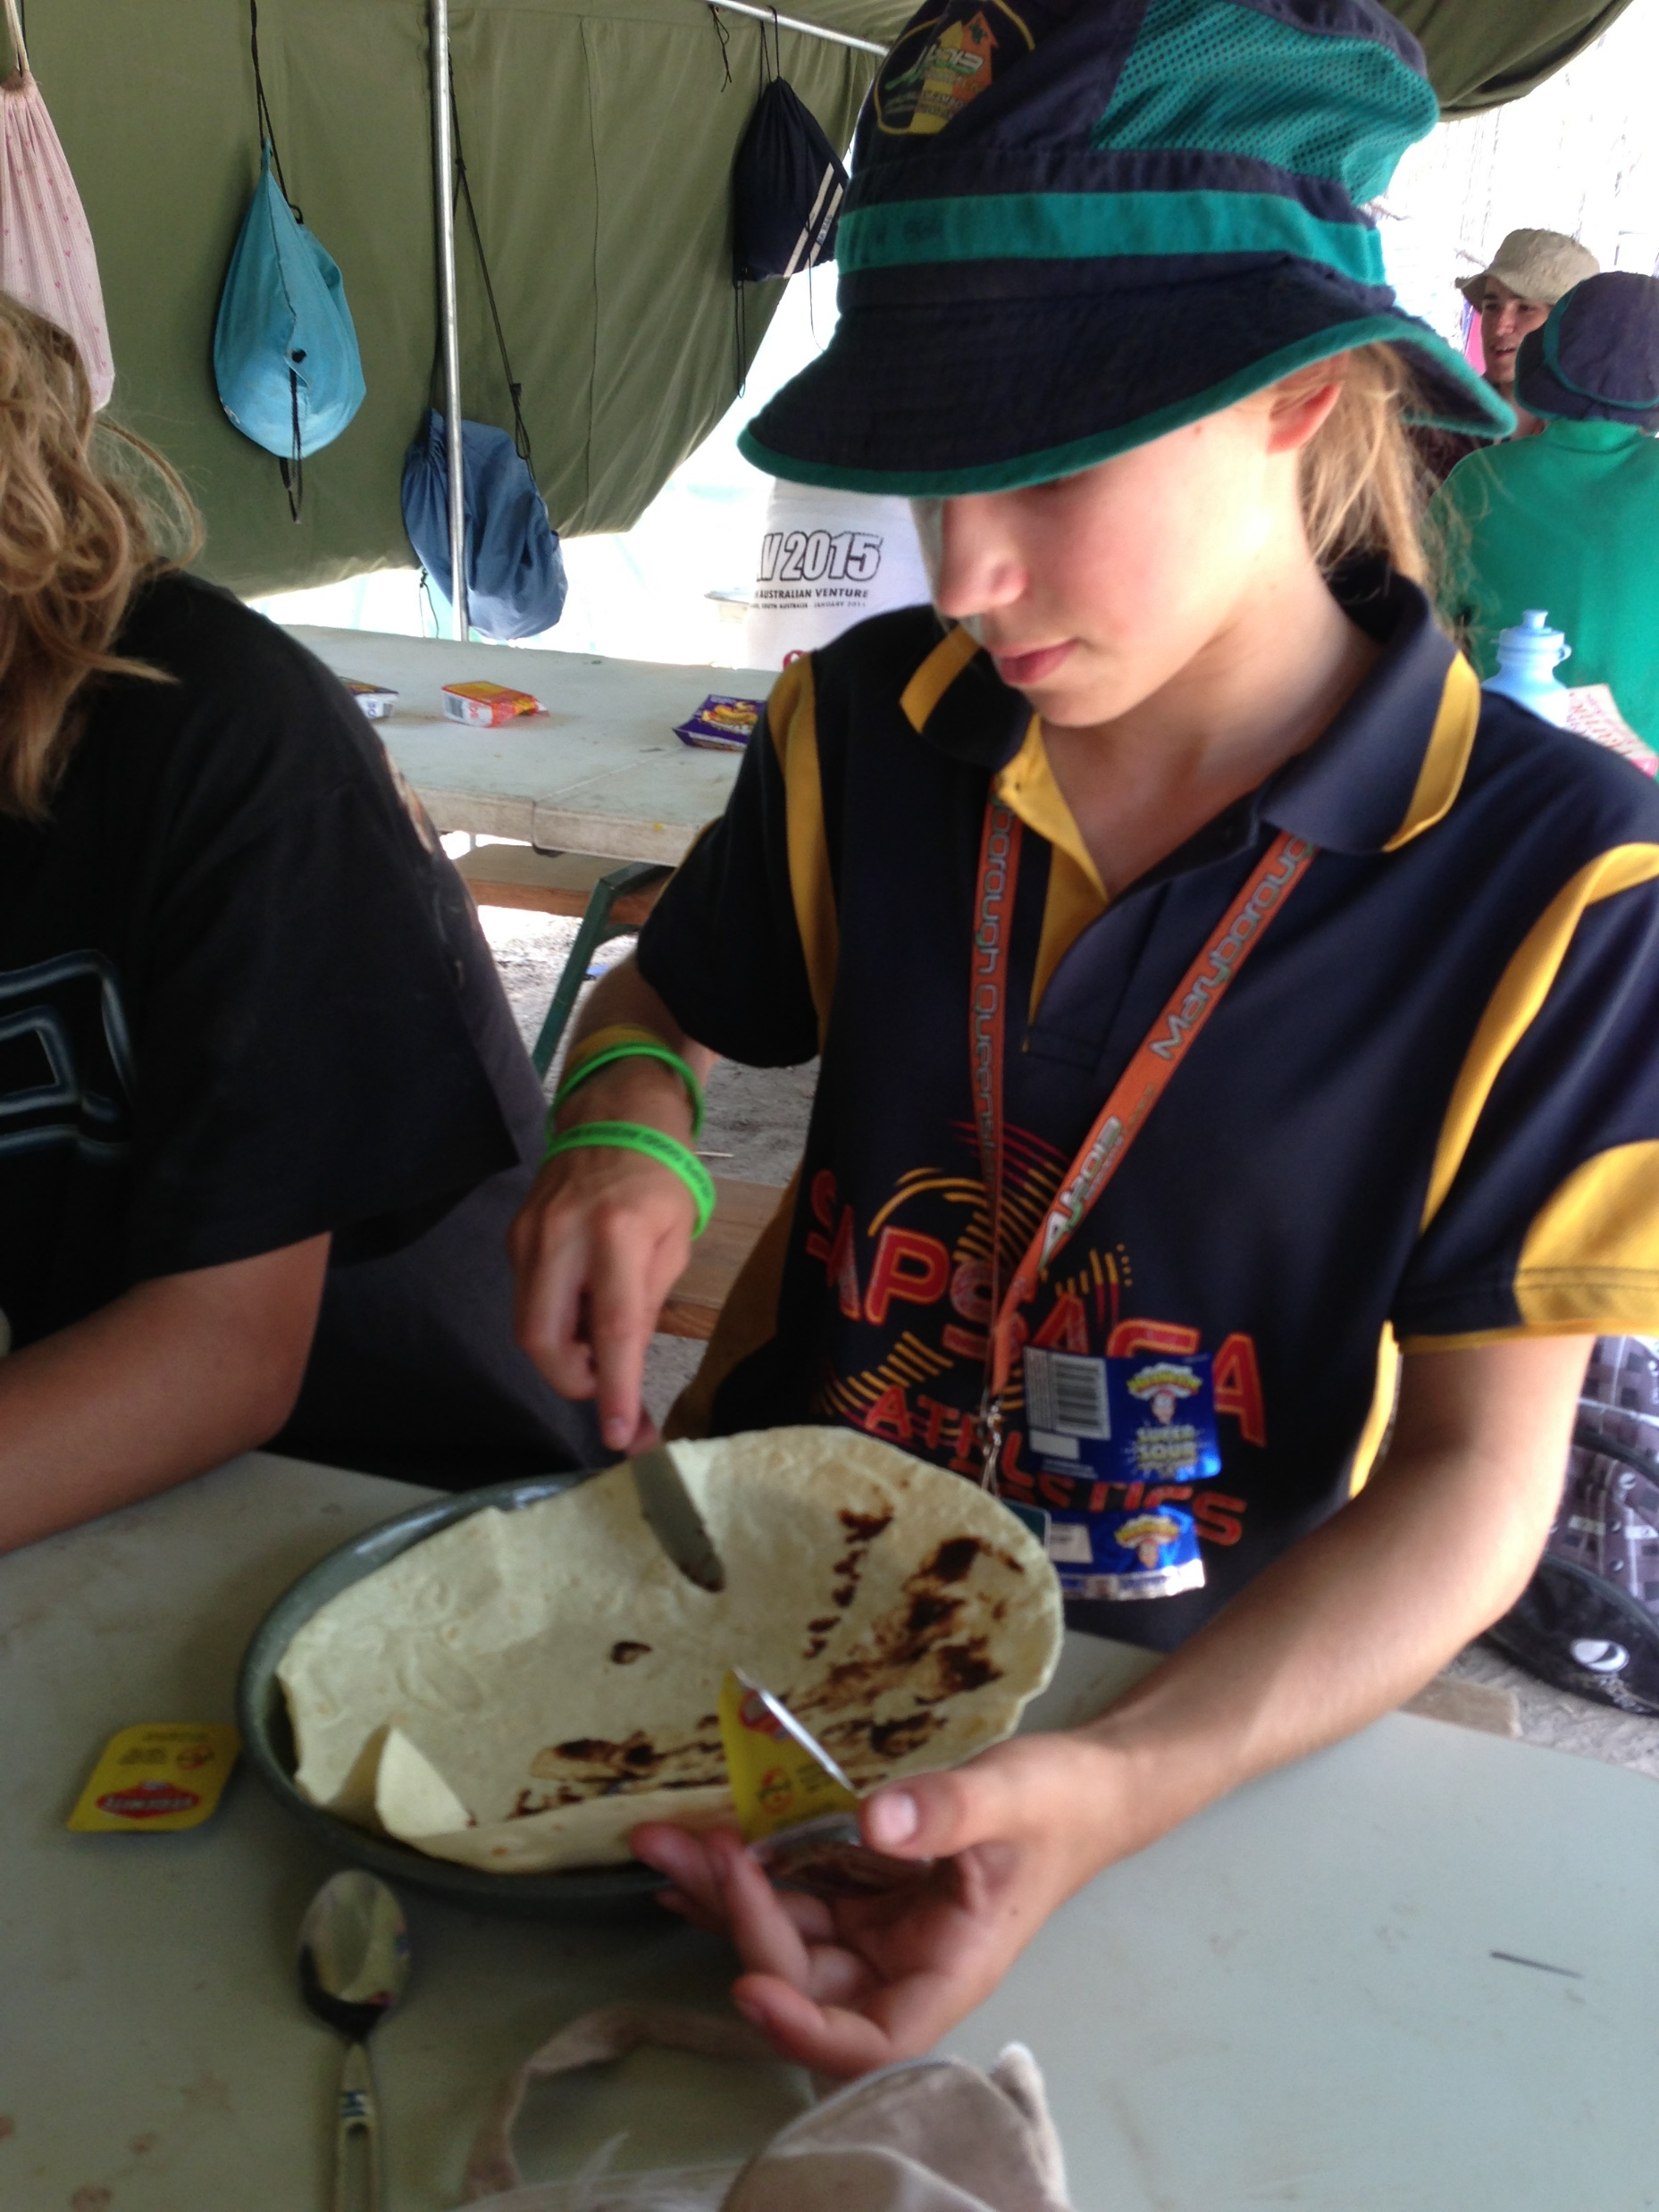
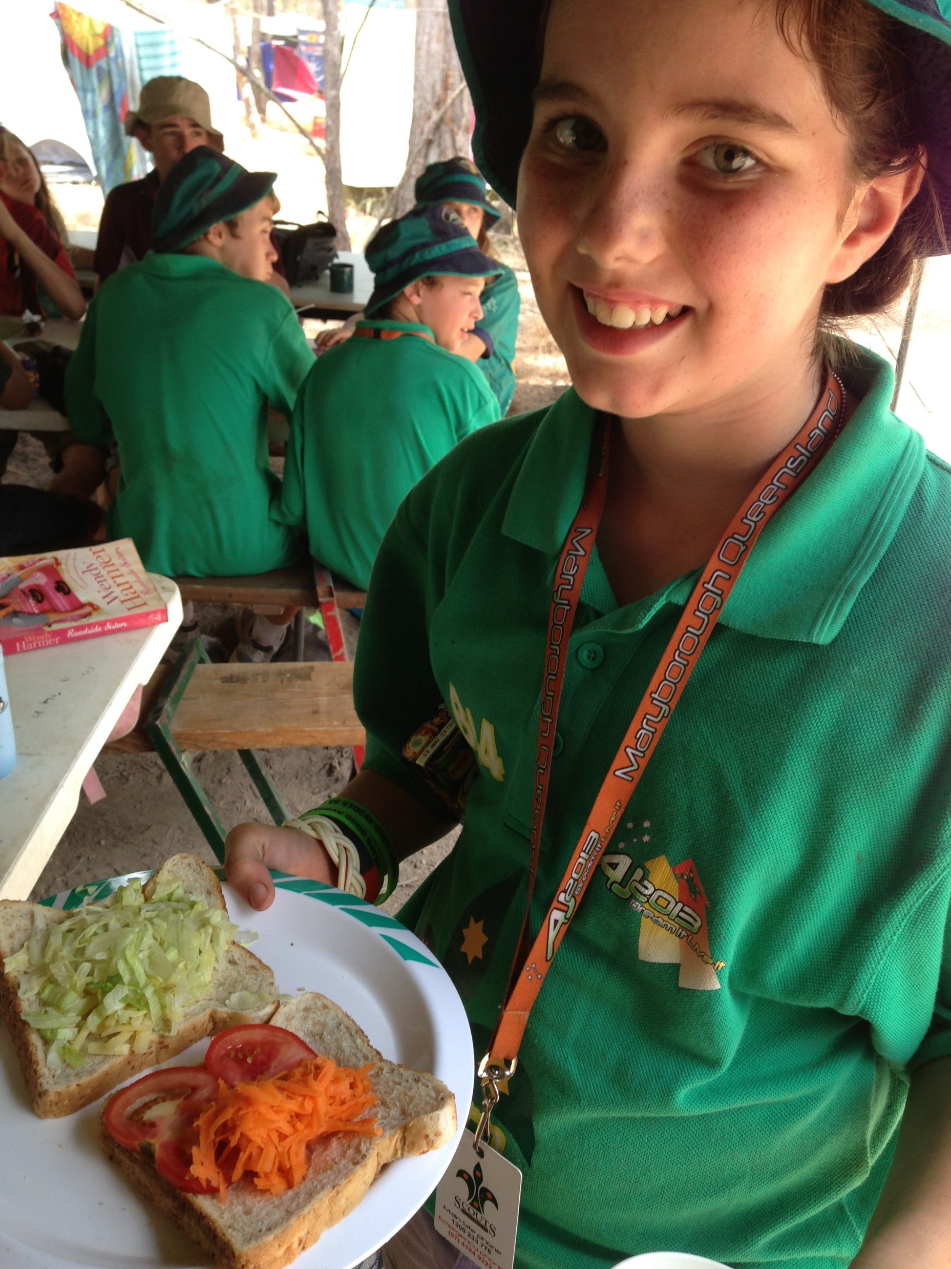
Jamboree Meals

Slide 39
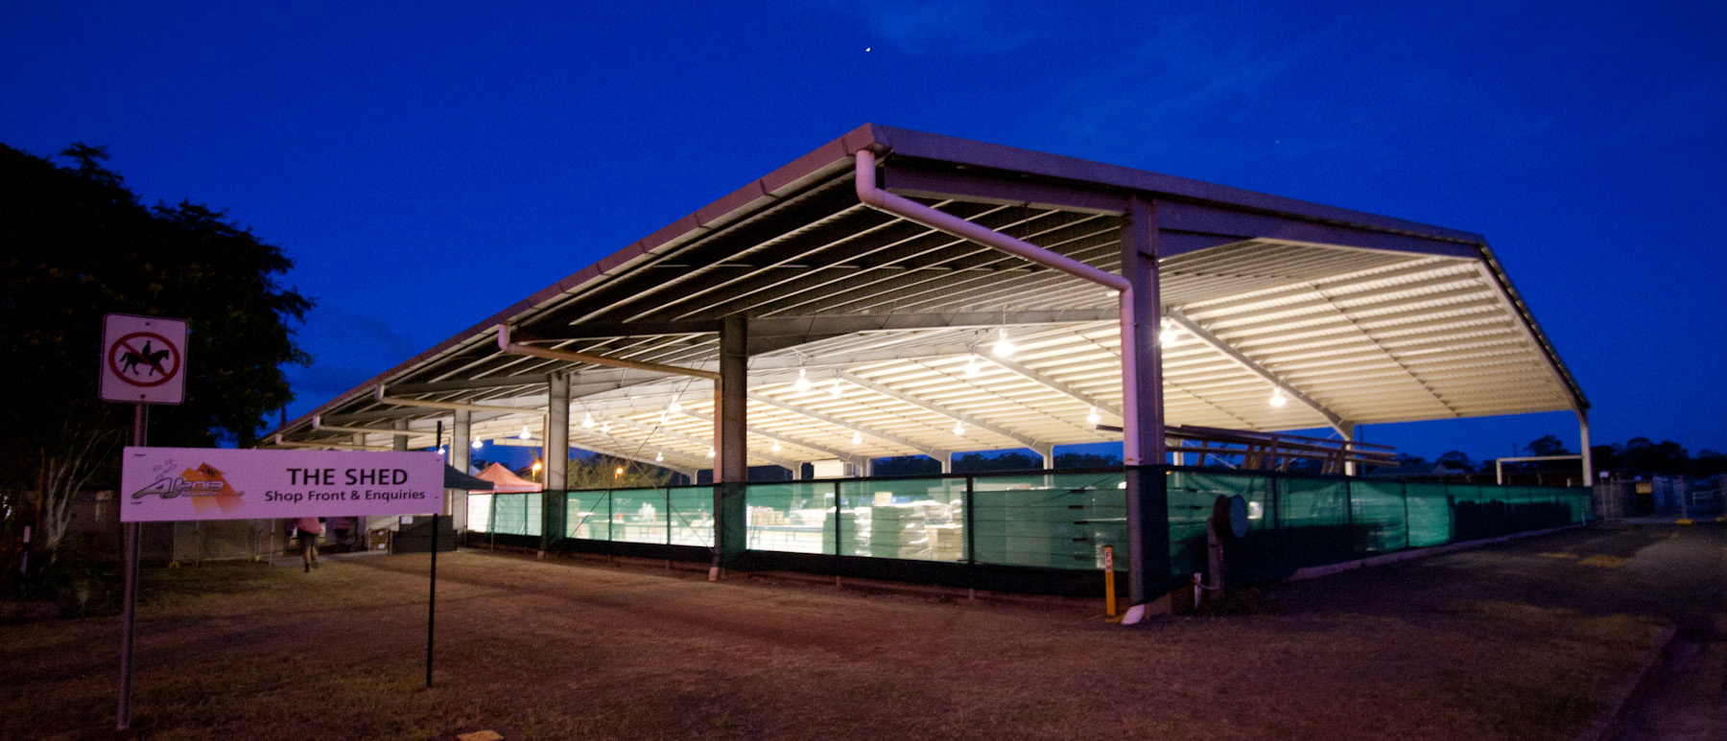

Slide 40
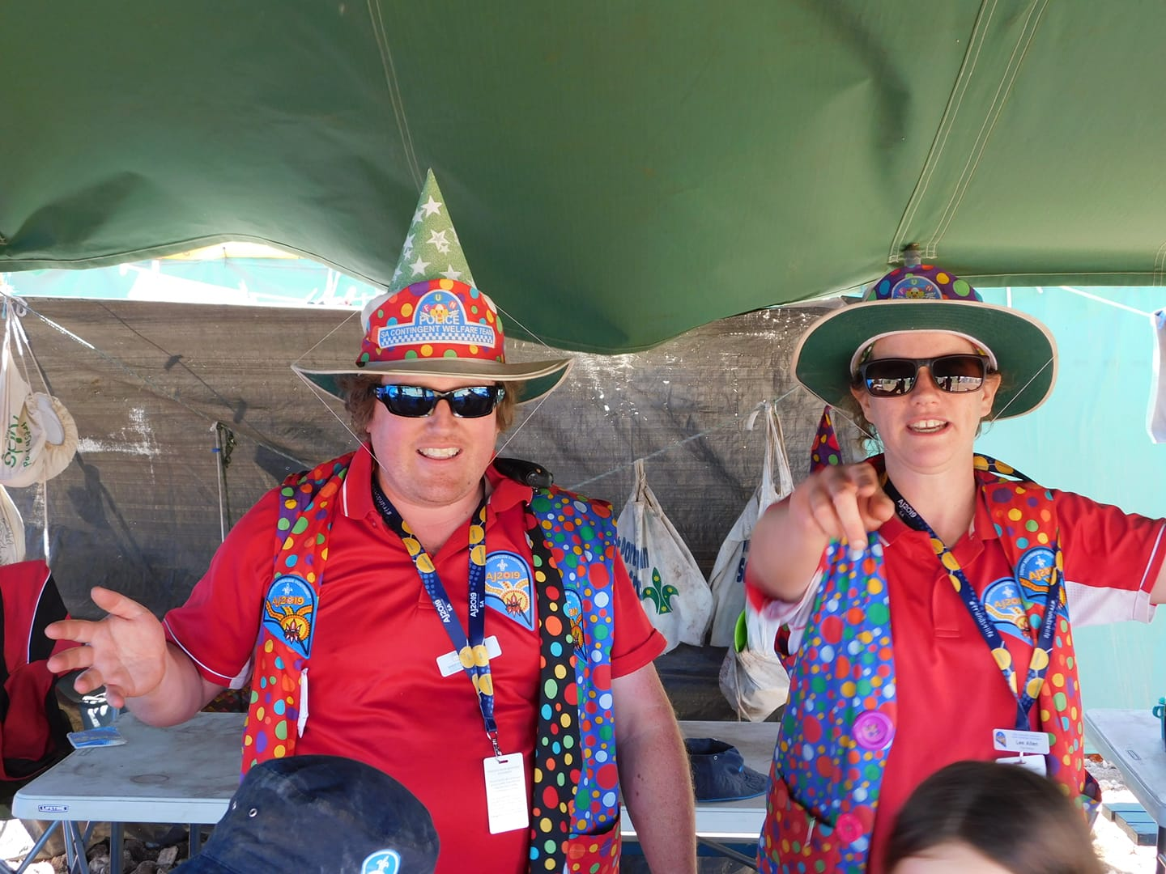
How are we supported?
The Fun Police
Well trained and experienced Unit Leaders
Contingent Team

Slide 41
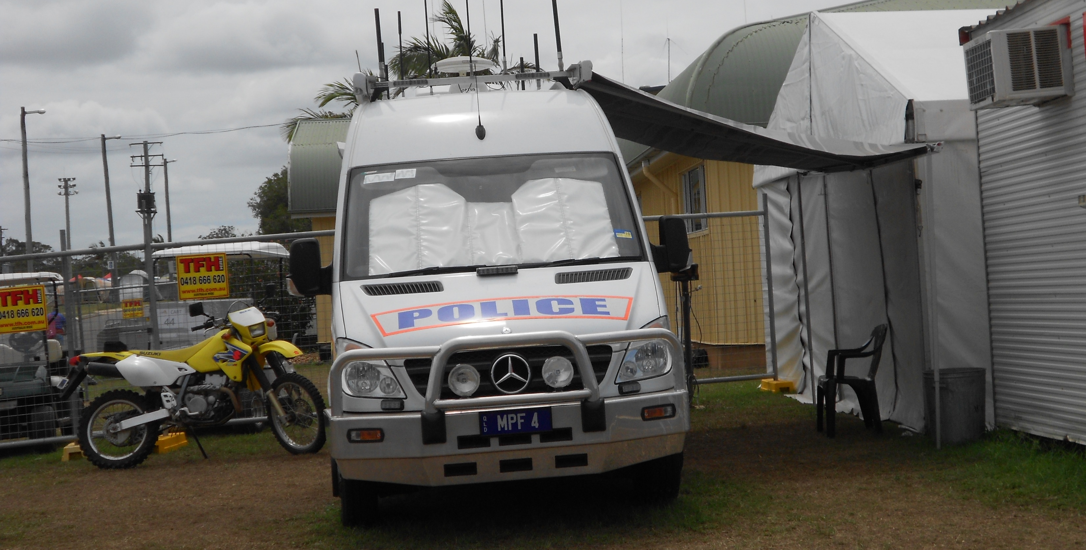
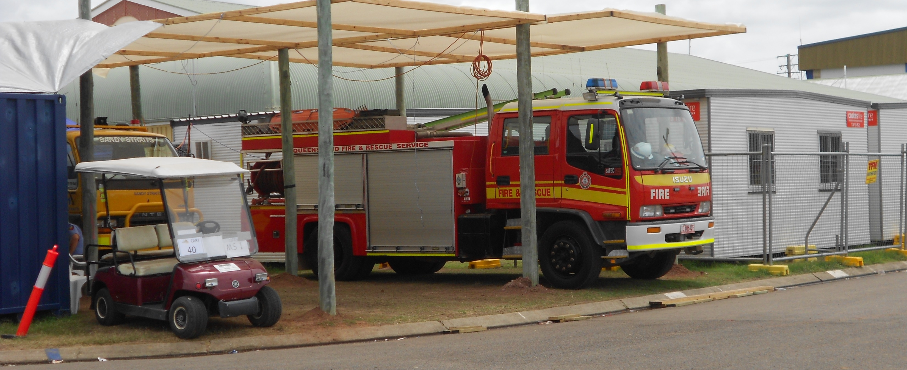
What if something goes wrong?
Medical
Protocols around
Contact with home
Contact with Jamboree
Safety and planning is key
Weather events factored in for the team to be aware of

Slide 42
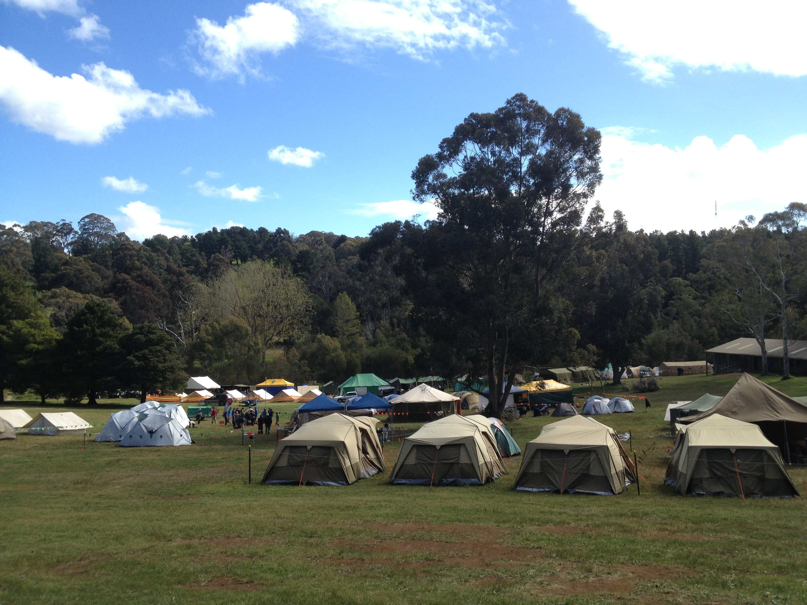
Preparing for Jamboree
Shakedown Camp
Long weekend in October 2024 at Woodhouse
For a successful Jamboree experience, attendance is required

Slide 43
What gear do I need to take?
What's supplied?
1 bag
1 back pack
Gear list will be released
Don't have something?
Christmas and Birthday presents

Slide 44
What is included?
Transport
Activities
Food
Jamboree Kit – shirt, scarf, badges
Contingent – shirt, badges, backpack, travel bag

Slide 45
Jamboree Fee
Participant Type | Total
Youth Participant | $2999
Venturer Service | $1850
Leader | $1850

Slide 46
Fundraising
Start Now!
Join together
Make a plan
Ideas

Slide 47
Eligibility

Slide 48
Eligibility – Scout Participants
Milestone 1
Bushcraft Stage 3
Bushwalking Stage 3
Camping Stage 3
10 nights camping under canvas as a Scout. 3 nights must be consecutive.

Slide 49
Eligibility – Scouts Participants
Current Scout section member at the time of application and through until at least 15 January 2025.
Not have had their 15th birthday as of 6 January 2025
i.e. Date of Birth after 6 January 2010
have consent from their parents/guardians.
be considered by their parents/guardians and Unit Council to be of both sufficient maturity and good behaviour to successfully participate in the event.
Be approved by their Contingent Leader

Slide 50
Eligibility – Venturer Participants
Venturer Scout choosing this category will be assigned to a Unit and a Patrol comprising of Scouts.
They will engage as a Scout in all activities and responsibilities.
Milestone 1
Bushcraft Stage 3
Bushwalking Stage 3
Camping Stage 3

Slide 51
Eligibility – Venturer Participants
Current registered Youth Member at the time of application and through until at least 15 January 2025.
Must not have had their 17th birthday as of 6 January 2025
ie. Date of Birth after 6 January 2008.
Have approval of their Unit Council and Group Leader

Slide 52
Eligibility – Venturer Service helpers
Have a desire to provide service to Scouts.
Have had their 16th birthday as of 6th January 2025 i.e. date of birth before 06 January 2008.
Registered Youth Member at the time of application and through until at least 15 January 2025.
Must have met the requirements, before 1st December 2024:
Milestone 1
Outdoor Adventure Skills Stage 3 in Bushcraft, Bushwalking, and Camping.
Be recommended by the Unit Council and Venturer Scout Leader as being of excellent character, a good role model to Scouts and has the skills and abilities to undertake the activity (or other tasks) nominated on the application form.
Must have consent from their parents/guardians.
Be approved by their Contingent Leader

Slide 53
Eligibility – Adult Support Roles
Current registered member of Scouts Australia
Appropriate clearances and training completed
Recommended by Team Leader i.e. Group Leader
Approved by Contingent Leader
Access full details on our website - http://jamboree.sa.scouts.com.au/who-can-attend/

Slide 54
Applications
Are now open
Online application process involves completing
Medical conditions
Special diets
Emergency contacts at time of Jamboree
ID Photo
Transport (independent travel etc)

Slide 55
Expressions of Interest
www.aj2025.com.au
No obligation, no cost
Keep up to date on all information
Helps your Contingent plan

Slide 56
Keep in touch
Contingent website – www.jamboree.sa.scouts.com.au
Social media – Facebook and Instagram
https://www.facebook.com/aj2025sa
https://www.instagram.com/sajamboreecontingent/
Complete your expression of interest to get updates

Slide 57
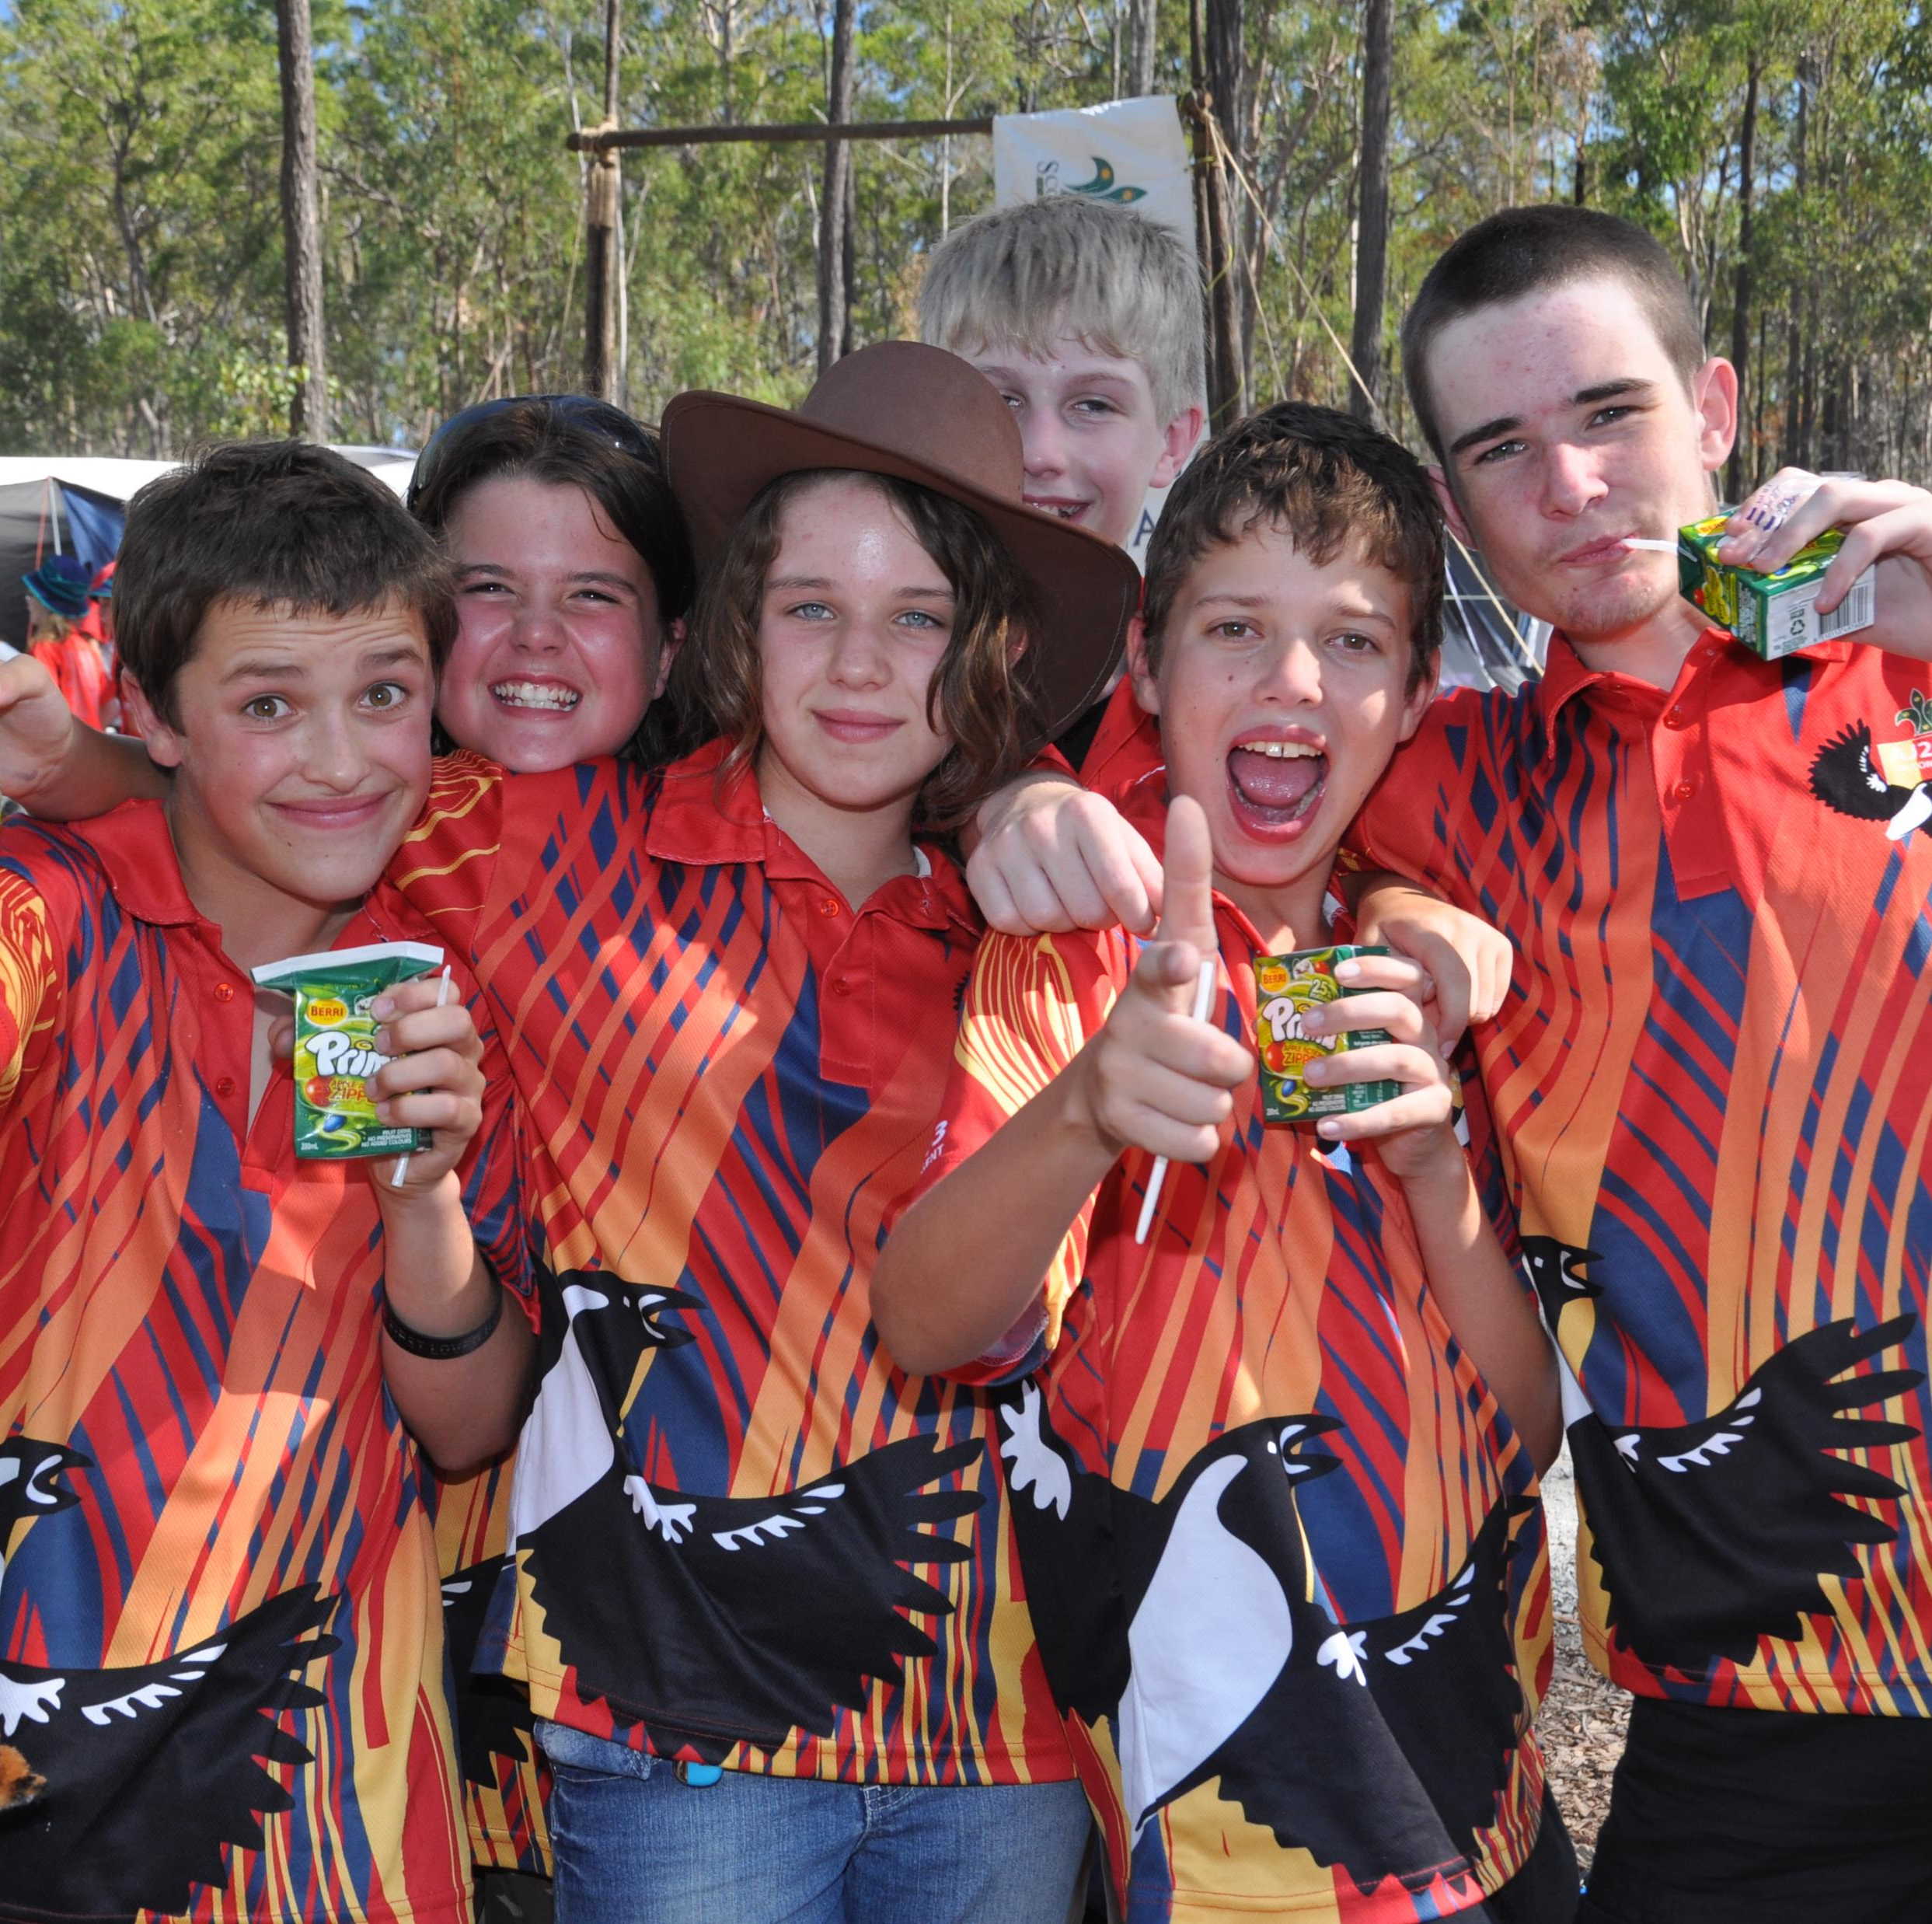
Questions
Thank you for attending
Don’t forget your expression of interest!

